Slide 1

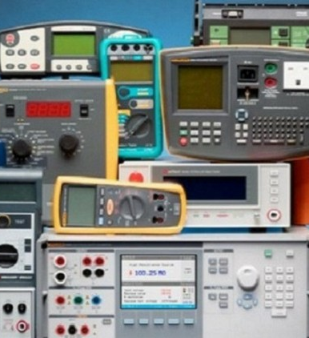

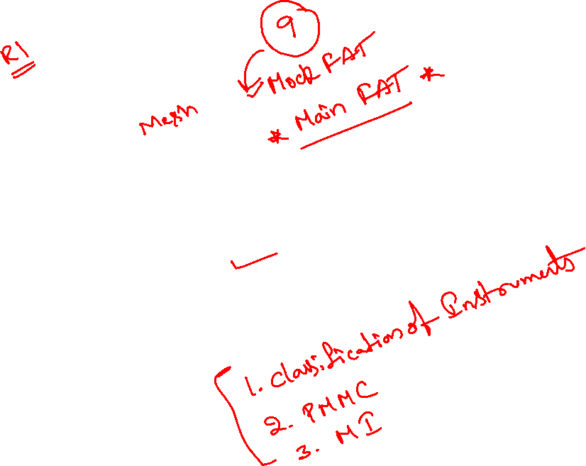
Measurements and instrumentation
Module 6

Slide 2

1. Classification of Instruments

Slide 3
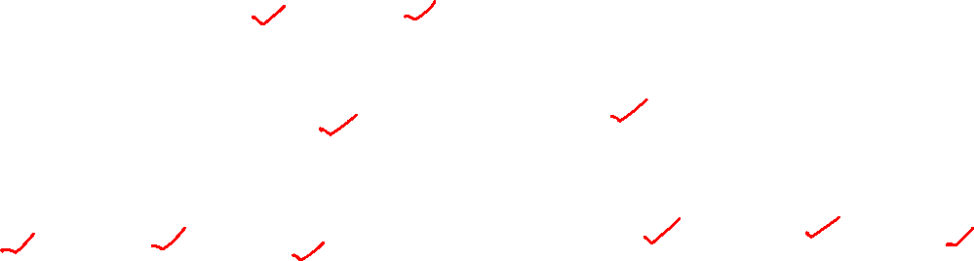
Classification of Instruments
Absolute instruments
Secondary instruments
Digital instruments
Analog instruments
Classified according to quantity they measure
Classified according to kind of current that can be measurand
Classified according to way the output is presented to the user
Indicating instruments
Recording instruments
Integrating instruments
Classified according to method used for comparison
Direct measuring
Comparison
Classified according to their accuracy class
Classified according to which of the effects is used for working

Slide 4
2. Working principle of PMMC
PMMC - Permanent Magnet Moving Coil

Slide 5

3. MI Instruments
MI – Moving Iron

Slide 6
4. Ammeter and Voltmeter

Slide 7
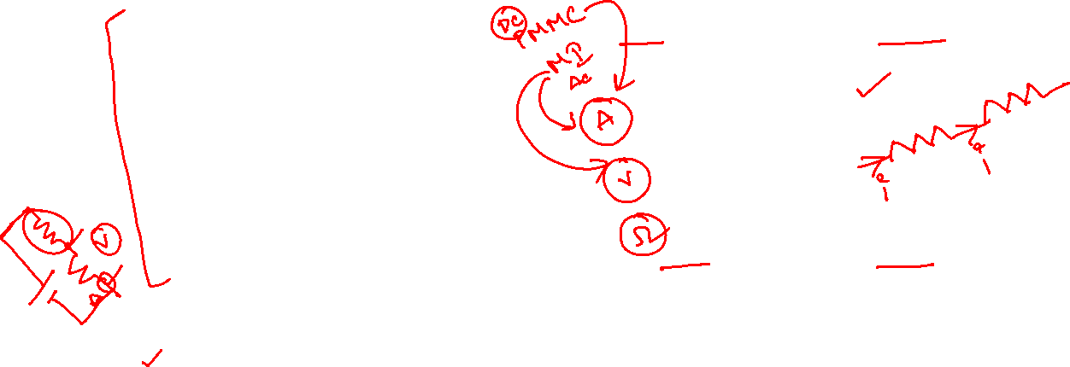
Measuring current, voltage, and resistance
Ammeter:
measures current (A)
connected in series
(current must go through instrument)
A
I
V
Voltmeter:
measures potential difference (V)
connected in parallel
a
b
Ohmmeter:
measures resistance of an isolated resistor (not in a working circuit)
Ω

Slide 8
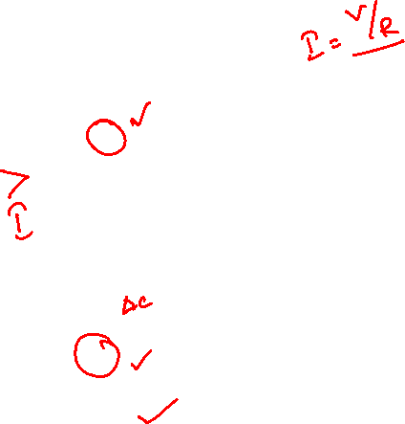
Effect of ammeter on circuit
Measuring current in a simple circuit:
R
connect ammeter in series
A
Are we measuring the correct current?
(the current in the circuit without ammeter)
V

Slide 9
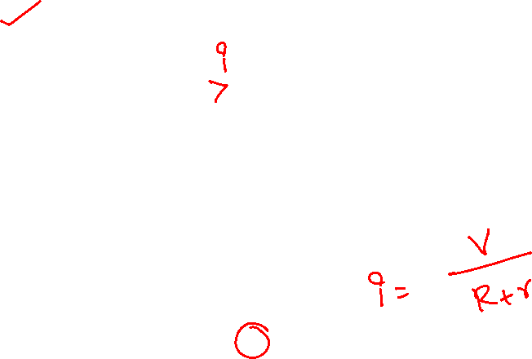
Effect of ammeter on circuit
Measuring current in a simple circuit:
R
connect ammeter in series
r
Are we measuring the correct current?
(the current in the circuit without ammeter)
V
any ammeter has some resistance r.
current in presence of ammeter is
current without the ammeter would be
To minimize error, ammeter resistance r must be very small.
(ideal ammeter would have zero resistance)

Slide 10
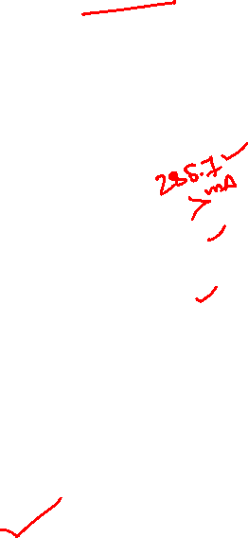
Example: an ammeter of resistance 10 mΩ is used to measure the current through a 10 Ω resistor in series with a 3 V battery that has an internal resistance of 0.5 Ω. What is the relative (percent) error caused by the ammeter?
R=10 Ω
Actual current without ammeter:
r=0.5 Ω
V=3 V
You might see the symbol ε used instead of V.

Slide 11
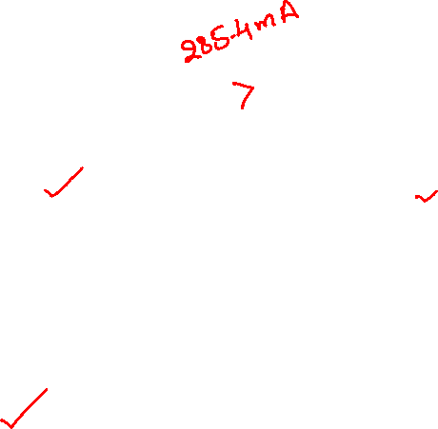
Current with ammeter:
R=10 Ω
R_{A}
r=0.5 Ω
V=3 V

Slide 12
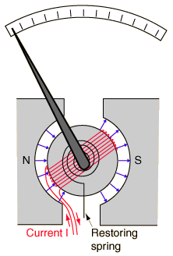
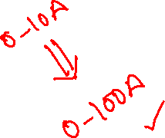
Designing an ammeter
ammeter can be based on galvanometer
(for electronic instrument, use electronic sensor instead, analysis still applies)
simplest case: send current directly through galvanometer, observe deflection of needle
Needle deflection is proportional to current. Each galvanometer has a certain maximum current corresponding to full needle deflection.
What if you need to measure a larger current?
use shunt resistor

Slide 13

Ammeter uses a galvanometer and a shunt, connected in parallel:
galvanometer
R_{G}
G
I_{G}
A
⇒
A
B
I
R_{SHUNT}
I
I_{SHUNT}
Everything inside the green box is the ammeter.
Current I gets split into I_{shunt} and I_{G}
Homework hint:
If your galvanometer reads 1A full scale but you want the ammeter to read 5A full scale, then R_{SHUNT} must result in I_{G}=1A when I=5A. What are I_{SHUNT} and V_{SHUNT}?

Slide 14
R_{G}
G
I_{G}
A
B
I
R_{SHUNT}
I_{SHUNT}
Shunt also reduces resistance of the ammeter:

Slide 15
A galvanometer-based ammeter uses a galvanometer and a shunt, connected in parallel:
Example: what shunt resistance is required for an ammeter to have a resistance of 10 mΩ, if the galvanometer resistance is 60 Ω?
R_{G}
G
I_{G}
I
R_{S}
I_{S}
(actually 0.010002 Ω)
To achieve such a small resistance, the shunt is probably a large-diameter wire or solid piece of metal.

Slide 16
Effect of voltmeter on circuit
R_{V}
Measuring voltage (potential difference) V_{ab} in a simple circuit:
I_{V}
connect voltmeter in parallel
R=10 Ω
Are we measuring the correct voltage?
(the voltage in the circuit without voltmeter)
a
b
voltmeter has some resistance R_{V}
r=0.5 Ω
current I_{V} flows through voltmeter
ε=3 V
extra current changes voltage drop across r and thus V_{ab}
To minimize error, voltmeter resistance r must be very large.
(ideal voltmeter would have infinite resistance)

Slide 17
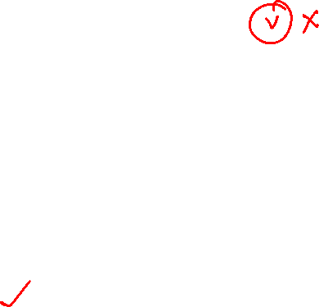
Example: a galvanometer of resistance 60 Ω is used to measure the voltage drop across a 10 kΩ resistor in series with an ideal 6 V battery and a 5 kΩ resistor. What is the relative error caused by the nonzero resistance of the galvanometer?
Actual voltage drop without instrument:
R₁=10 kΩ
a
b
R₂=5 kΩ
V=6 V

Slide 18

The measurement is made with the galvanometer.
60 Ω and 10 kΩ resistors in parallel are equivalent to 59.6 Ω resistor.
Total equivalent resistance: 5059.6 Ω
Total current: I=1.186x10⁻³ A
R_{G}=60 Ω
G
R₁=10 kΩ
a
b
V_{ab} = 6V – IR₂ = 0.07 V.
R₂=5 kΩ
The relative error is:
V=6 V
I=1.19 mA
Would you pay for this voltmeter?
Would you pay for this voltmeter?
We need a better instrument!

Slide 19
Example: a voltmeter of resistance 100 kΩ is used to measure the voltage drop across a 10 kΩ resistor in series with an ideal 6 V battery and a 5 kΩ resistor. What is the percent error caused by the nonzero resistance of the voltmeter?
R₁=10 kΩ
We already calculated the actual voltage drop (2 slides back).
a
b
R₂=5 kΩ
V=6 V

Slide 20
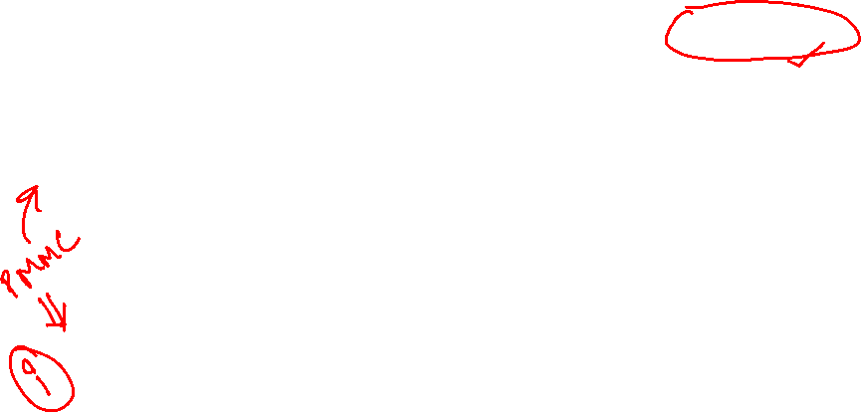
The measurement is now made with the “better” voltmeter.
100 kΩ and 10 kΩ resistors in parallel are equivalent to an 9090 Ω resistor.
Total equivalent resistance: 14090 Ω
Total current: I=4.26x10⁻⁴ A
R_{V}=100 kΩ
V
R₁=10 kΩ
a
b
The voltage drop from a to b:
6-(4.26x10⁻⁴)(5000)=3.87 V.
R₂=5 kΩ
The percent error is.
V=6 V
I=.426 mA
Not great, but much better.

Slide 21

Designing a voltmeter
voltmeter must have a very large resistance
voltmeter can be made from galvanometer in series with a large resistance
R_{Ser}
R_{G}
a
V
b
⇒
a
G
b
V_{ab}
V_{ab}
Everything inside the blue box is the voltmeter.
Homework hints: “the galvanometer reads 1A full scale” would mean a current of I_{G}=1A would produce a full-scale deflection of the galvanometer needle.
If you want the voltmeter shown to read 10V full scale, then the selected R_{Ser} must result in I_{G}=1A when V_{ab}=10V.
Homework hints: “the galvanometer reads 1A full scale” would mean a current of I_{G}=1A would produce a full-scale deflection of the galvanometer needle.
If you want the voltmeter shown to read 10V full scale, then the selected R_{Ser} must result in I_{G}=1A when V_{ab}=10V.

Slide 22
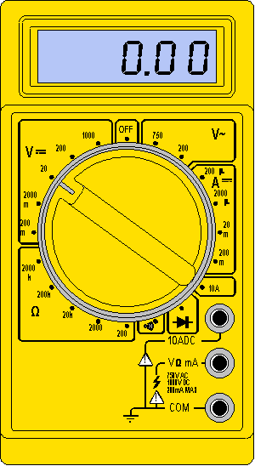
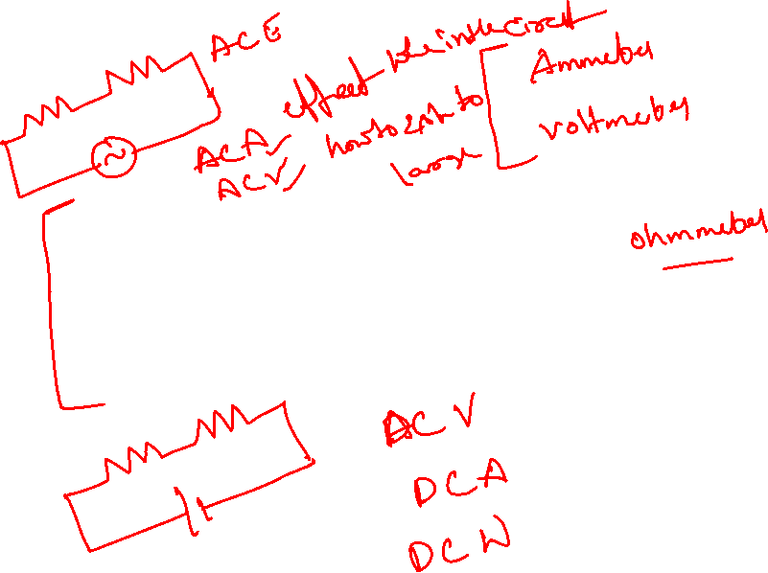
5. Digital multimeters

Slide 23

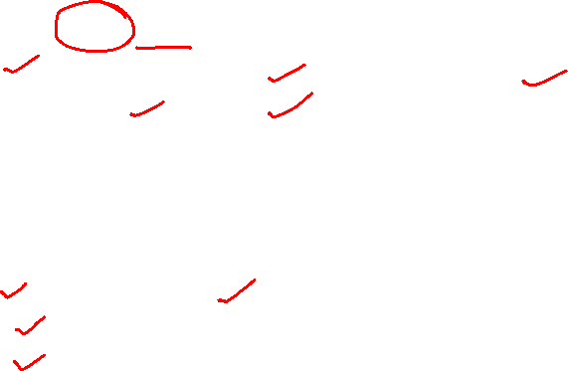
What is a multimeter?
A multimeter is a devise used to measure voltage, resistance and current in electronics & electrical equipment
It is also used to test continuity between to 2 points to verify if there is any breaks in circuit or line
There are two types of multimeter Analog & Digital
Analog has a needle style gauge
Digital has a LCD display (Referenced during this PPT)

Slide 24
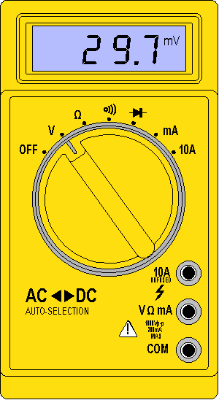
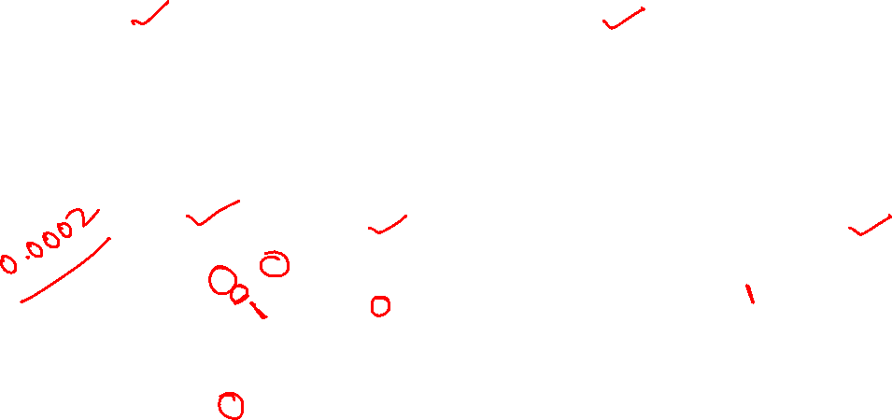
There are 2 styles of multimeters
Switched
Manually switch between ranges to get most accurate reading.
Auto Range Switches between ranges automatically for best reading.
Both of these styles work the same

Slide 25
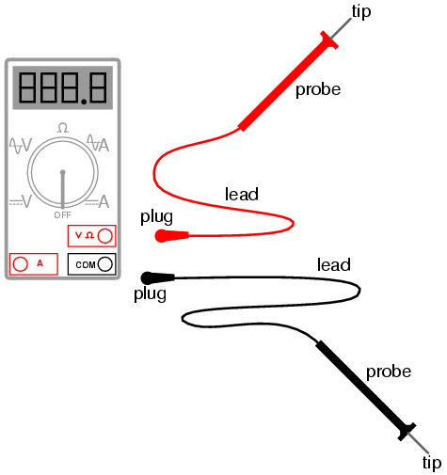
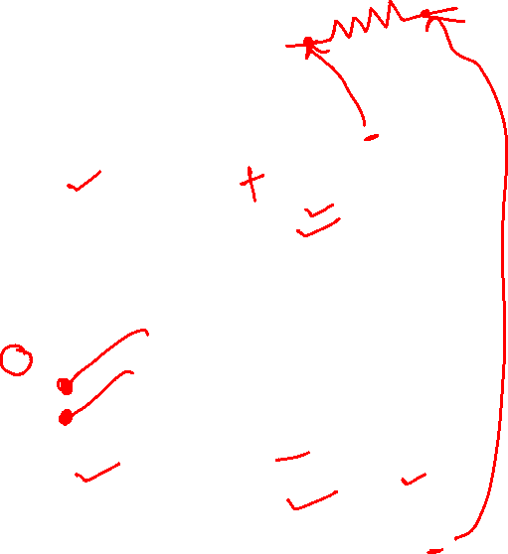
Meter leads
Red meter lead Is connected to Voltage/Resistance or amperage port Is considered the positive connection
Probes Are the handles used to hold tip on the tested connection
Tips Are at the end of the probe and provides a connection point
Black meter lead Is always connected to the common port Is considered the negative connection

Slide 26
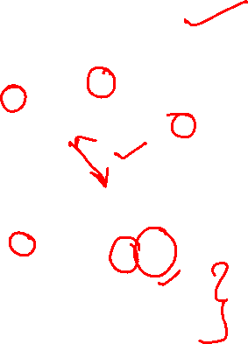
Display & Dial Settings
Digital Display Shows measured value.
Meter Dial Turn dial to change functions. Turn dial to OFF position after use.
Panel Indicator Shows each function and setting range to turn dial to.
Probe Connections Specific for each function.

Slide 27
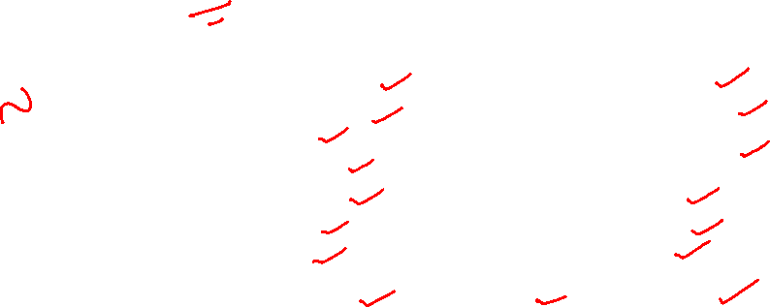
Common DMM Symbols
~ AC Voltage Ground
--- DC Voltage ( Capacitor
Hz Hertz μF MicroFarad
+ Positive μ Micro
Negative m Milli
Ω Ohms M Mega
* Diode K Kilo
))) Audible Continuity OL Overload
These symbols are often found on multimeter and schematics.
They are designed to symbolize components and reference values.

Slide 28
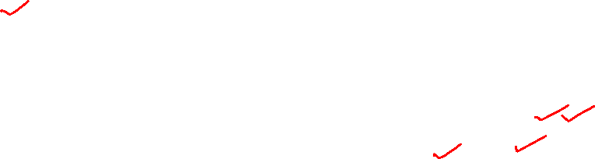
Measuring Voltage
Voltage (V) is the unit of electrical pressure; one volt is the potential difference needed to cause one amp of current to pass through one ohm of resistance
Voltage is broke up into 2 sections AC & DC
Alternating Current (AC) is house voltage (110vac)
Direct Current (DC) is battery voltage (12vdc)
On switched meters use one value higher than your expected value
Be very careful to not touch any other electronic components within the equipment and do not touch the tips to each other while connected to anything else
To measure voltage connect the leads in parallel between the two points where the measurement is to be made. The multimeter provides a parallel pathway so it needs to be of a high resistance to allow as little current flow through it as possible

Slide 29
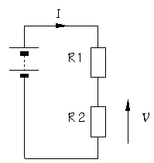
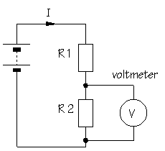

Measuring Voltage

Slide 30
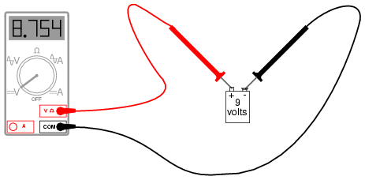
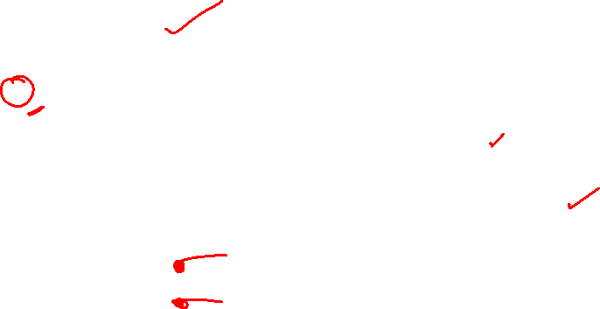
Measuring Voltage
9.0vdc

Slide 31

Measuring Resistance and Continuity
Resistance (Ω) is the opposition to current
Resistance is measured in Ohm's
Disconnect power source before testing
Remove component or part from system before testing
Measure using lowest value, if OL move to next level
Testing for continuity is used to test to verify if a circuit, wire or fuse is complete with no open
Audible continuity allows an alarm if circuit is complete
If there is no audible alarm resistance of 1ohm to .1ohm should be present

Slide 32
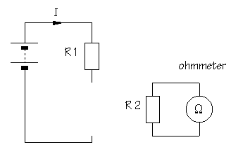
Measuring Resistance

Slide 33
Measuring or Testing Continuity

Slide 34
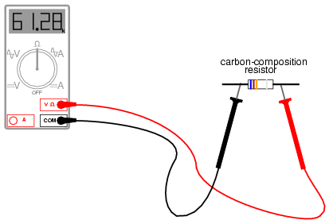
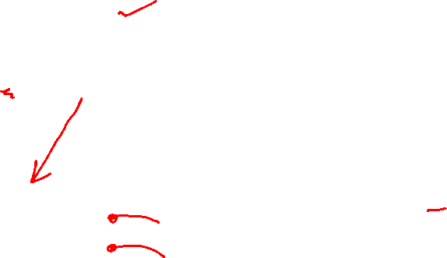
Measuring Resistance
100Ω

Slide 35

Measuring Continuity
.5Ω
Fuse
5 amp

Slide 36
Measuring Current
Current (amps) is the flow of electrical charge though a component or conductor
Current is measured in amps or amperes
Disconnect power source before testing
Disconnect completed circuit at end of circuit
Place multimeter in series with circuit
Reconnect power source and turn ON
Select highest current setting and work your way down.

Slide 37
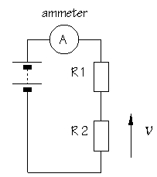
Measuring Current

Slide 38
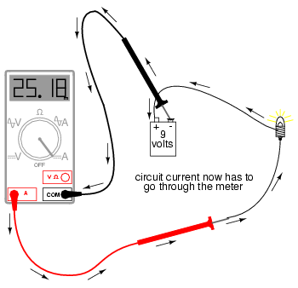
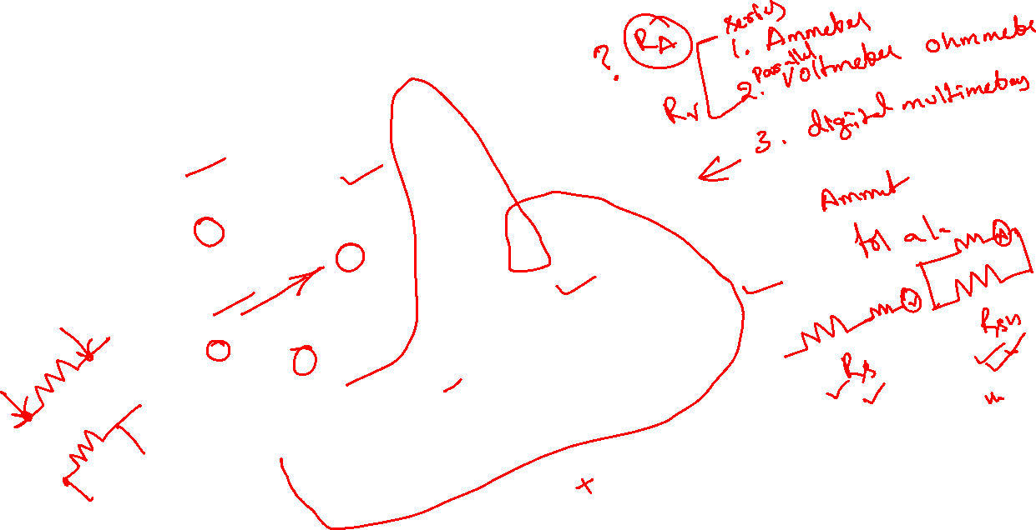
Measuring Current
1.1amps

Slide 39
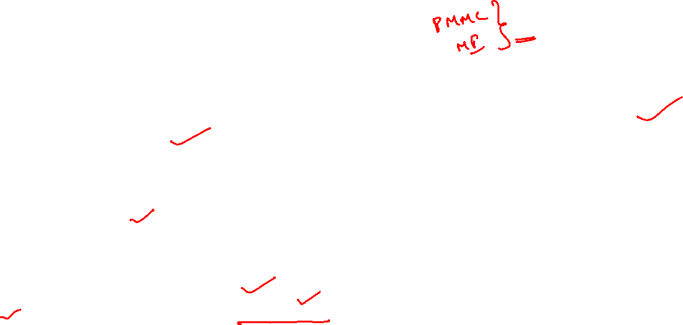
overview
A meter capable of checking for voltage, current, and resistance is called a multimeter,
When measuring Voltage the multimeter must be connected to two points in a circuit in order to obtain a good reading. Be careful not to touch the bare probe tips together while measuring voltage, as this will create a short-circuit!
Never read Resistance or test for Continuity with a multimeter on a circuit that is energized.
When measuring Current the multimeter must be connected in a circuit so the electrons have to flow through the meter
Multimeters have practically no resistance between their leads. This is intended to allow electrons to flow through the meter with the least possible difficulty. If this were not the case, the meter would add extra resistance in the circuit, thereby affecting the current

